Slide 1
Design pattern
In java

Slide 2
Best Book for design pattern
Christopher Alexander was the first person who invented all the above Design Patterns in 1977.
But later the Gang of Four - Design patterns, elements of reusable object-oriented software book was written by a group of four persons named as Erich Gamma, Richard Helm, Ralph Johnson and John Vlissides in 1995.
That's why all the above 23 Design Patterns are known as Gang of Four (GoF) Design Patterns.

Slide 3
What is design pattern?
A design patterns are well-proved solution for solving the specific problem/task.
But remember one-thing, design patterns are programming language independent strategies for solving the common object-oriented design problems. That means, a design pattern represents an idea, not a particular implementation.
By using the design patterns you can make your code more flexible, reusable and maintainable. It is the most important part because java internally follows design patterns.
When should we use the design patterns?
We must use the design patterns during the analysis and requirement phase of SDLC(Software Development Life Cycle).
Design patterns ease the analysis and requirement phase of SDLC by providing information based on prior hands-on experiences.

Slide 4
Advantage of design pattern:
They are reusable in multiple projects.
They provide the solutions that help to define the system architecture.
They provide transparency to the design of an application.
They are well-proved and testified solutions since they have been built upon the knowledge and experience of expert software developers.
Design patterns don?t guarantee an absolute solution to a problem. They provide clarity to the system architecture and the possibility of building a better system.

Slide 5
Categorization of design patterns:
Basically, design patterns are categorized into two parts:
Core Java (or JSE) Design Patterns.
JEE Design Patterns.
Core Java Design Patterns:
1.Creational Design Pattern
Factory Pattern
Abstract Factory Pattern
Singleton Pattern
Prototype Pattern
Builder Pattern.
6.Object pool Pattern

Slide 6
Continue…
2. Structural Design Pattern
Adapter Pattern
Bridge Pattern
Composite Pattern
Decorator Pattern
Facade Pattern
Flyweight Pattern
Proxy Pattern
3. Behavioral Design Pattern
Chain Of Responsibility Pattern
Command Pattern
Interpreter Pattern
Iterator Pattern
Mediator Pattern
Memento Pattern
Observer Pattern
State Pattern
Strategy Pattern
Template Pattern
Visitor Pattern

Slide 7
Creational design patterns
Creational design patterns are concerned with the way of creating objects. These design patterns are used when a decision must be made at the time of instantiation of a class (i.e. creating an object of a class).
Types of creational design patterns
There are following 6 types of creational design patterns.
1)Factory Method Pattern
A Factory Pattern or Factory Method Pattern says that just define an interface or abstract class for creating an object but let the subclasses decide which class to instantiate. In other words, subclasses are responsible to create the instance of the class.
The Factory Method Pattern is also known as Virtual Constructor.

Slide 8
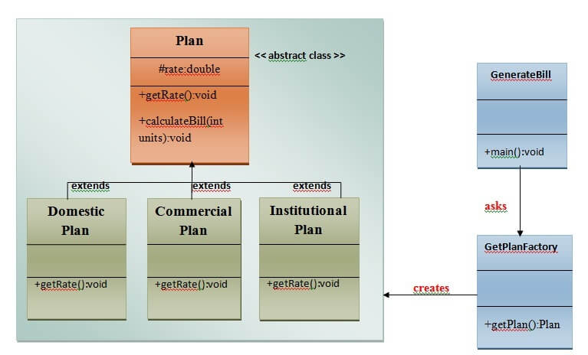

Slide 9
Abstract Factory Pattern
Abstract Factory patterns work around a super-factory which creates other factories. This factory is also called as factory of factories.
Abstract Factory Pattern says that just define an interface or abstract class for creating families of related (or dependent) objects but without specifying their concrete sub-classes. Abstract Factory Pattern is one level higher than the Factory Pattern.
An Abstract Factory Pattern is also known as Kit.

Slide 10
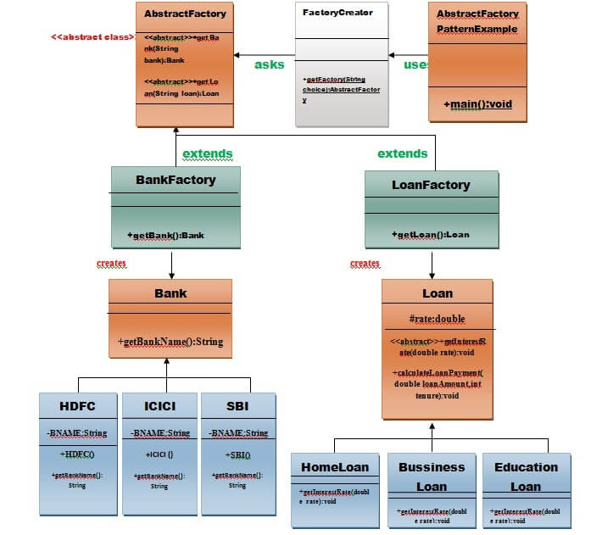

Slide 11
continue
3. Singleton Pattern:
Singleton Pattern says that just"define a class that has only one instance and provides a global point of access to it".
In other words, a class must ensure that only single instance should be created and single object can be used by all other classes.
There are two forms of singleton design pattern
Early Instantiation: creation of instance at load time.
Lazy Instantiation: creation of instance when required.
How to create Singleton design pattern?
To create the singleton class, we need to have static member of class, private constructor and static factory method.

Slide 12
Continue…
Understanding early Instantiation of Singleton Pattern
In such case, we create the instance of the class at the time of declaring the static data member, so instance of the class is created at the time of classloading.
class A{
private static A obj=new A();//Early, instance will be created at load time
private A(){}
public static A getA(){
return obj;
}
public void doSomething(){
//write your code
}
}

Slide 13
Continue…
Understanding lazy Instantiation of Singleton Pattern
In such case, we create the instance of the class in synchronized method or synchronized block, so instance of the class is created when required.
class A{ private static A obj;
private A(){}
public static A getA(){
if (obj == null){
synchronized(A.class){
if (obj == null){

Slide 14
Continue…
obj = new A();//instance will be created at request time
}
}
}
return obj;
}
public void doSomething(){
//write your code
}
}

Slide 15
Prototype Pattern
Prototype Pattern says that cloning of an existing object instead of creating new one and can also be customized as per the requirement.
This pattern should be followed, if the cost of creating a new object is expensive and resource intensive.

Slide 16
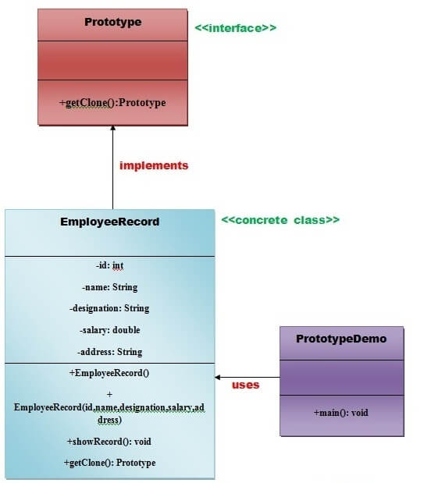

Slide 17
Builder Design Pattern
Builder Pattern says that "construct a complex object from simple objects using step-by-step approach"
It is mostly used when object can't be created in single step like in the de-serialization of a complex object.

Slide 18
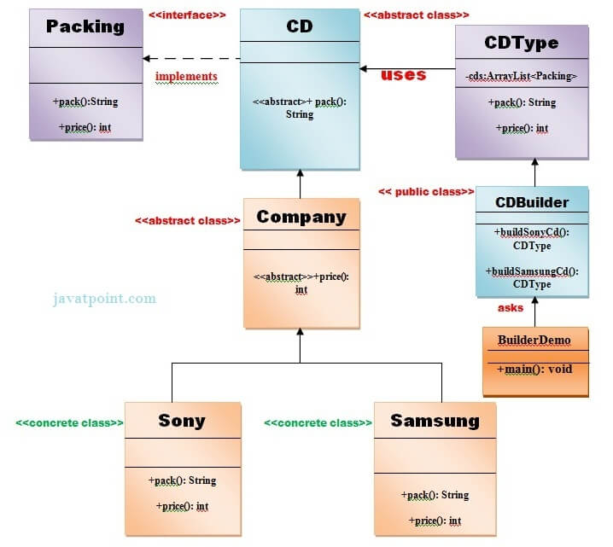

Slide 19
Object Pool Pattern
Mostly, performance is the key issue during the software development and the object creation, which may be a costly step.
Object Pool Pattern says that " to reuse the object that are expensive to create".
Basically, an Object pool is a container which contains a specified amount of objects. When an object is taken from the pool, it is not available in the pool until it is put back. Objects in the pool have a lifecycle: creation, validation and destroy.

Slide 20
Structural Design Pattern
These design patterns are about organizing different classes and objects to form larger structures and provide new functionality.
using inheritance and composition to create a large structure from small structure.
Structural design patterns are Adapter, Bridge, Composite, Decorator, Facade, Flyweight, Proxy.
Use Case Of Structural Design Pattern-
1) When 2 interfaces are not compatible with each other and want to establish a relationship between them through an adapter it’s called an adapter design pattern. The adapter pattern converts the interface of a class into another interface or class that the client expects, i.e adapter lets classes work together that could not otherwise because of incompatibility. so in these types of incompatible scenarios, we can go for the adapter pattern.

Slide 21
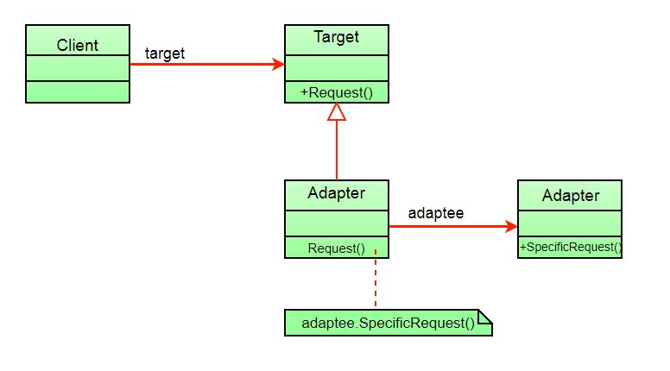
Types of Structural Design Pattern
1Adapter Design Pattern: The adapter pattern convert the interface of a class into another interface clients expect.
Adaptee

Slide 22
Continue..
Note: The client sees only the target interface and not the adapter. The adapter implements the target interface. Adapter delegates all requests to Adaptee.
Example:
Suppose you have a Bird class with fly() , and makeSound()methods. And also a ToyDuck class with squeak() method. Let’s assume that you are short on ToyDuck objects and you would like to use Bird objects in their place. Birds have some similar functionality but implement a different interface, so we can’t use them directly. So we will use adapter pattern. Here our client would be ToyDuck and adaptee would be Bird.
Program is on Eclipse Test

Slide 23
The Bridge design pattern
The Bridge design pattern allows you to separate the abstraction from the implementation.
There are 2 parts in Bridge design pattern :
1)Abstraction 2)Implementation
This is a design mechanism that encapsulates an implementation class inside of an interface class.
The bridge pattern allows the Abstraction and the Implementation to be developed independently and the client code can access only the Abstraction part without being concerned about the Implementation part.
The abstraction is an interface or abstract class and the implementer is also an interface or abstract class.

Slide 24
The abstraction contains a reference to the implementer. Children of the abstraction are referred to as refined abstractions, and children of the implementer are concrete implementers. Since we can change the reference to the implementer in the abstraction, we are able to change the abstraction’s implementer at run-time.
Changes to the implementer do not affect client code.It increases the loose coupling between class abstraction and it’s implementation.
Elements of Bridge Design Pattern
Abstraction – core of the bridge design pattern and defines the crux. Contains a reference to the implementer.
Refined Abstraction – Extends the abstraction takes the finer detail one level below. Hides the finer elements from implemetors.
Implementer – It defines the interface for implementation classes. This interface does not need to correspond directly to the abstraction interface and can be very different. Abstraction imp provides an implementation in terms of operations provided by the Implementer interface.
Concrete Implementation – Implements the above implementer by providing the concrete implementation.

Slide 25
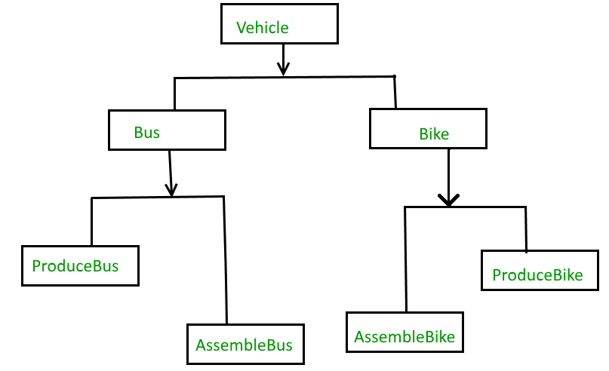
Without Bridge Pattern

Slide 26
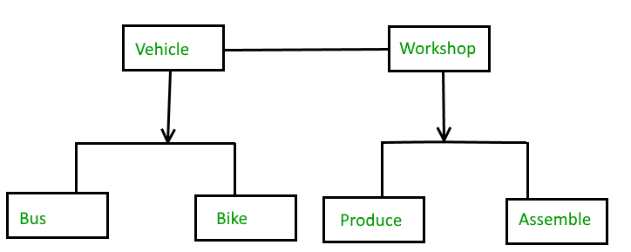
With Bridge Pattern

Slide 27
Composite Design Pattern
Composite pattern is a partitioning design pattern and describes a group of objects that is treated the same way as a single instance of the same type of object. The intent of a composite is to “compose” objects into tree structures to represent part-whole hierarchies. It allows you to have a tree structure and ask each node in the tree structure to perform a task.
The Composite Pattern has four participants:
Component – Component declares the interface for objects in the composition and for accessing and managing its child components. It also implements default behavior for the interface common to all classes as appropriate.
Leaf – Leaf defines behavior for primitive objects in the composition. It represents leaf objects in the composition.
Composite – Composite stores child components and implements child related operations in the component interface.
Client – Client manipulates the objects in the composition through the component interface.

Slide 28
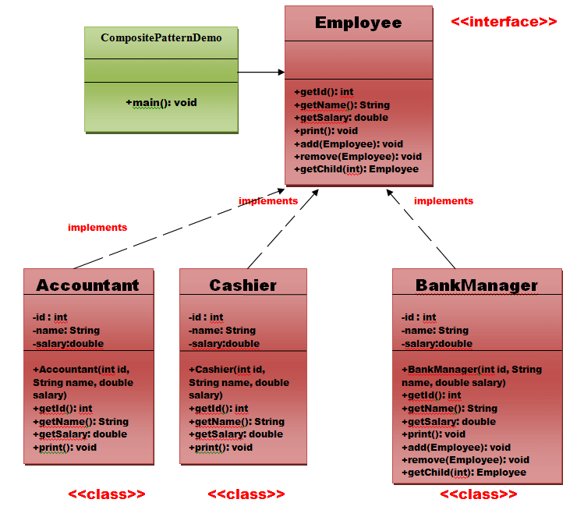
Component
Composite
Devloper
Manager
CompanyDirector
Leaf

Slide 29
Decorator design pattern
Decorator design pattern allows us to dynamically add functionality and behavior to an object without affecting the behavior of other existing objects within the same class. We use inheritance to extend the behavior of the class.

Slide 30
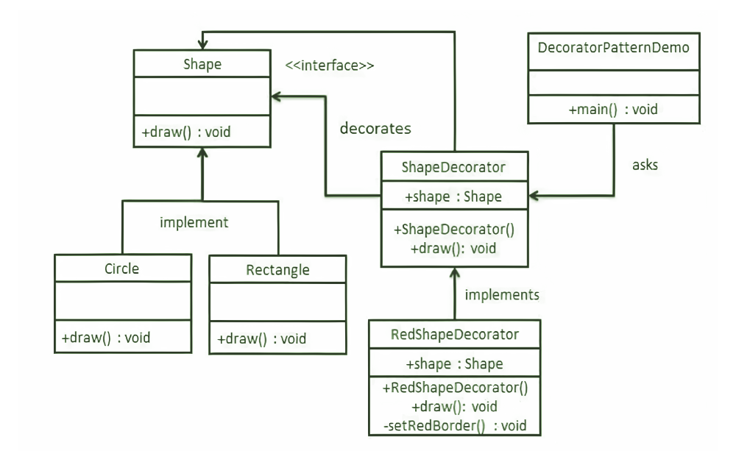

Slide 31
Facade Pattern
A Facade Pattern says that just ”just provide a unified and simplified interface to a set of interfaces in a subsystem, therefore it hides the complexities of the subsystem from the client”.

Slide 32
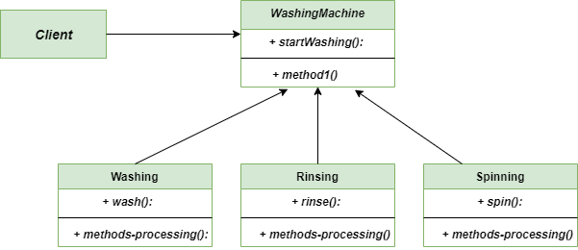

Slide 33
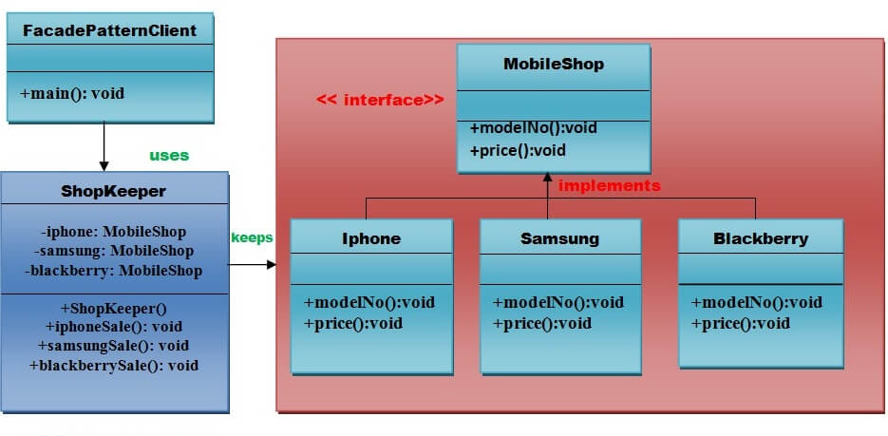

Slide 34
Flyweight Pattern
A Flyweight Pattern says that just "to reuse already existing similar kind of objects by storing them and create new object when no matching object is found".
Why to use Flyweight Design Pattern in this example? Here we use the Fly Weight design pattern, since here we need to reduce the object count for players. Now we have n number of players playing CS 1.6, if we do not follow the Fly Weight Design Pattern then we will have to create n number of objects, one for each player. But now we will only have to create 2 objects one for terrorists and other for counter terrorists, we will reuse then again and again whenever required.

Slide 35
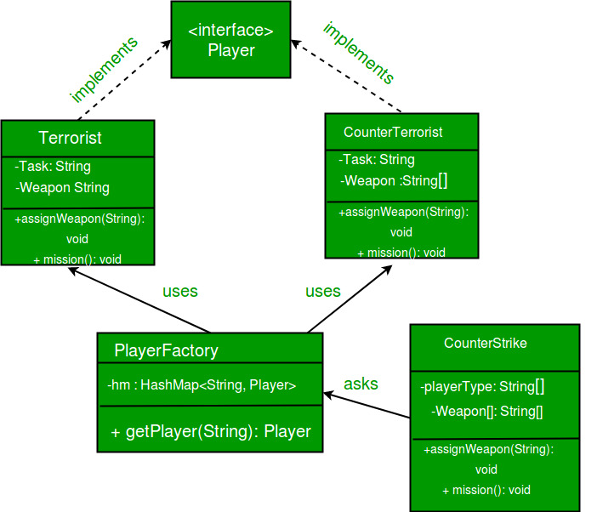

Slide 36
Proxy Pattern
Proxy means ‘in place of’, representing’ or ‘in place of’ or ‘on behalf of’ are literal meanings of proxy and that directly explains Proxy Design Pattern. Proxies are also called surrogates, handles, and wrappers.
According to GoF, a Proxy Pattern "provides the control for accessing the original object".
A real world example can be a cheque or credit card is a proxy for what is in our bank account. It can be used in place of cash, and provides a means of accessing that cash when required. And that’s exactly what the Proxy pattern does – “Controls and manage access to the object they are protecting“.

Slide 37
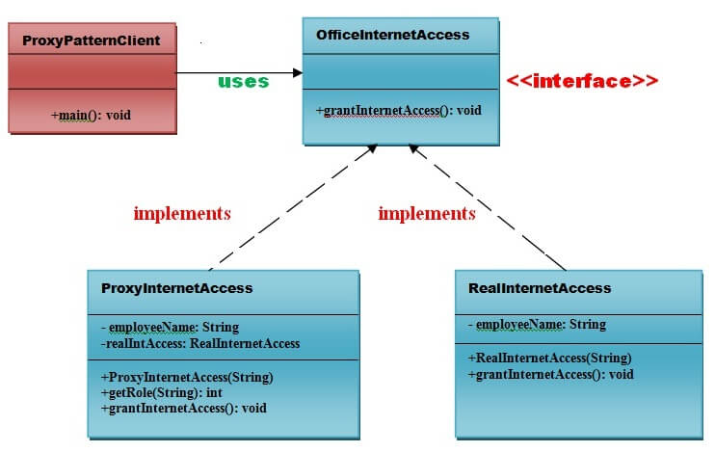

Slide 38
Behavioral design patterns
Behavioral design patterns are concerned with the interaction and responsibility of objects.
In these design patterns, the interaction between the objects should be in such a way that they can easily talk to each other and still should be loosely coupled.
That means the implementation and the client should be loosely coupled in order to avoid hard coding and dependencies.
Behavioral patterns are Chain of responsibility, Command, Interpreter, Iterator, Mediator, Memento, Null Object, Observer, State, Strategy, Template method, Visitor .

Slide 39
Chain of responsibility pattern
Chain of responsibility pattern is used to achieve loose coupling in software design where a request from the client is passed to a chain of objects to process them.
Later, the object in the chain will decide themselves who will be processing the request and whether the request is required to be sent to the next object in the chain or not.
Where and When Chain of Responsibility pattern is applicable :
When you want to decouple a request’s sender and receiver
Multiple objects, determined at runtime, are candidates to handle a request
When you don’t want to specify handlers explicitly in your code
When you want to issue a request to one of several objects without specifying the receiver explicitly.

Slide 41
A Command Pattern
A Command Pattern says that "encapsulate a request under an object as a command and pass it to invoker object.
Invoker object looks for the appropriate object which can handle this command and pass the command to the corresponding object and that object executes the command".
Program in eclipse.

Slide 42
An Interpreter Pattern
An Interpreter Pattern says that "to define a representation of grammar of a given language, along with an interpreter that uses this representation to interpret sentences in the language".

Slide 43
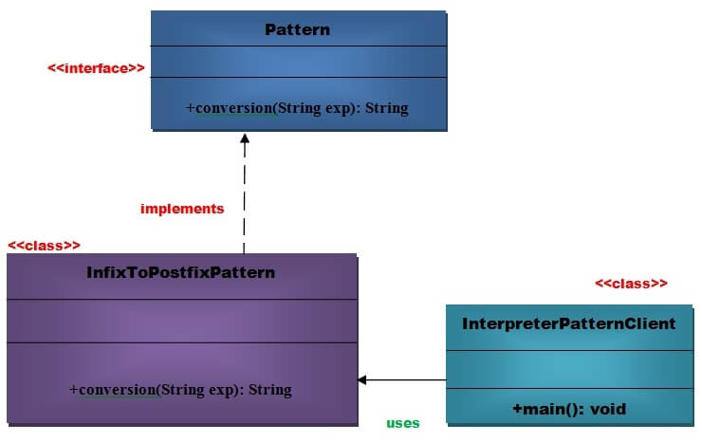
Infix expression example: a+b*c
Its corresponding postfix expression: abc*+

Slide 44
Iterator Pattern
According to GoF, Iterator Pattern is used "to access the elements of an aggregate object sequentially without exposing its underlying implementation".
The Iterator pattern is also known as Cursor.(A cursor is use to iterate or travers or retriev a collection or stream objects elements one by one Innumaration,List-iterator )
Note: java.util.Iterator interface uses Iterator Design Pattern.

Slide 45
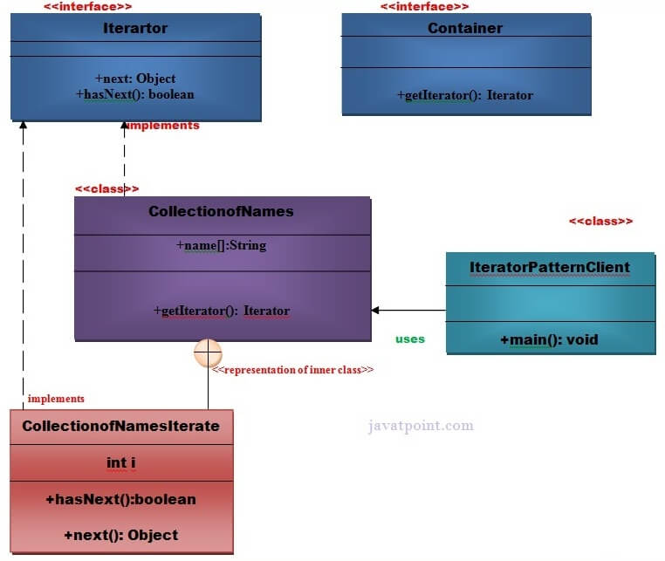

Slide 46
A Mediator Pattern
A Mediator Pattern says that "to define an object that encapsulates how a set of objects interact".
I will explain the Mediator pattern by considering a problem. When we begin with development, we have a few classes and these classes interact with each other producing results. Now, consider slowly, the logic becomes more complex when functionality increases. Then what happens? We add more classes and they still interact with each other but it gets really difficult to maintain this code now. So, Mediator pattern takes care of this problem.
Mediator pattern is used to reduce communication complexity between multiple objects or classes. This pattern provides a mediator class which normally handles all the communications between different classes and supports easy maintainability of the code by loose coupling.
Usage:
It is commonly used in message-based systems likewise chat applications.
When the set of objects communicate in complex but in well-defined ways.

Slide 47
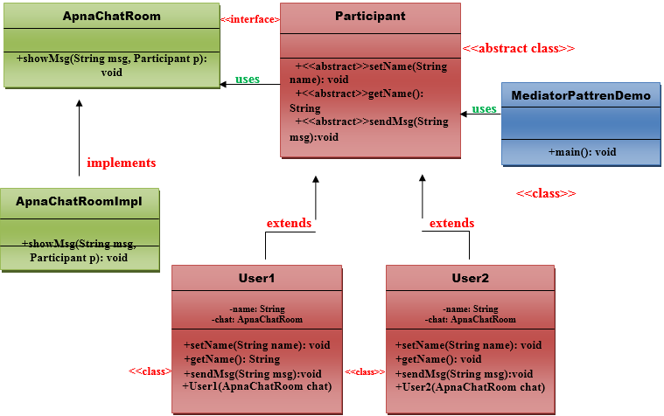

Slide 48
A Memento Pattern
A Memento Pattern says that "to restore the state of an object to its previous state". But it must do this without violating Encapsulation. Such case is useful in case of error or failure.
Note: Undo or backspace or ctrl+z is one of the most used operation in an editor. Memento design pattern is used to implement the undo operation. This is done by saving the current state of the object as it changes state.

Slide 49
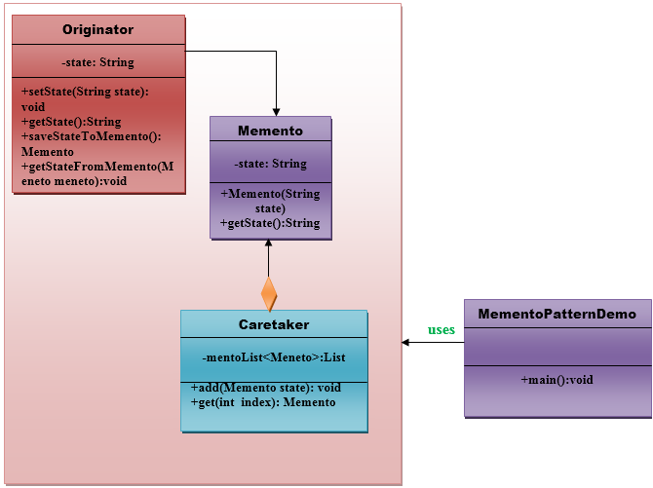

Slide 50
Observer Pattern
The Observer Pattern defines a one to many dependency between objects so that one object changes state, all of its dependents are notified and updated automatically.
Observer pattern
To understand observer pattern, first you need to understand the subject and observer objects.
The relation between subject and observer can easily be understood as an analogy to magazine subscription.
A magazine publisher(subject) is in the business and publishes magazines (data).
If you(user of data/observer) are interested in the magazine you subscribe(register), and if a new edition is published it gets delivered to you.
If you unsubscribe(unregister) you stop getting new editions.
Publisher doesn’t know who you are and how you use the magazine, it just delivers it to you because you are a subscriber(loose coupling).

Slide 51
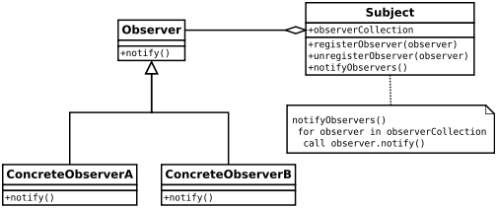
One to many dependency is between Subject(One) and Observer(Many).
There is dependency as Observers themselves don’t have access to data. They are dependent on Subject to provide them data.

Slide 52
A State Pattern
State design pattern is used when an Object changes its behavior based on its internal state.
If we have to change behavior of an object based on its state, we can have a state variable in the Object and use if-else condition block to perform different actions based on the state. State pattern is used to provide a systematic and lose-coupled way to achieve this through Context and State implementations.
Usage:
When the behavior of object depends on its state and it must be able to change its behavior at runtime according to the new state.

Slide 53
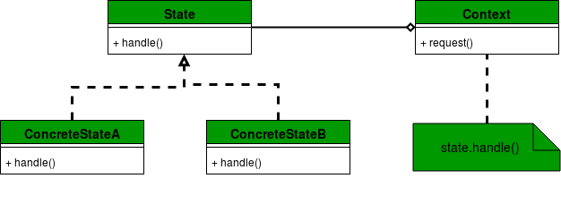
Context: Defines an interface to client to interact. It maintains references to concrete state object which may be used to define current state of object.
State: Defines interface for declaring what each concrete state should do.
ConcreteState: Provides implementation for methods defined in State.

Slide 54
Continue…
Example of State Design Pattern In below example, we have implemented a mobile state scenario . With respect to alerts, a mobile can be in different states. For example, vibration and silent. Based on this alert state, behavior of the mobile changes when an alert is to be done.

Slide 55
Strategy Pattern
A Strategy Pattern says that "defines a family of functionality, encapsulate each one, and make them interchangeable".
The Strategy Pattern is also known as Policy.

Slide 56
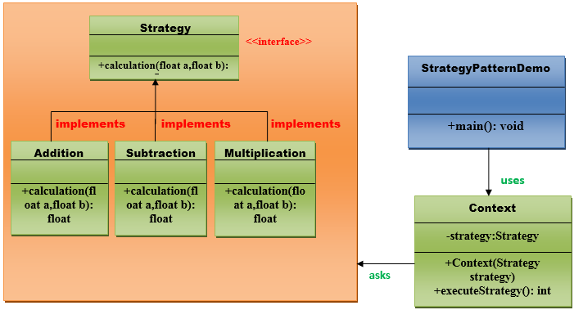

Slide 57
A Template Pattern
A Template Pattern says that "just define the skeleton of a function in an operation, deferring some steps to its subclasses".
Benefits:
It is very common technique for reusing the code.This is only the main benefit of it.
Usage:
It is used when the common behavior among sub-classes should be moved to a single common class by avoiding the duplication.

Slide 58
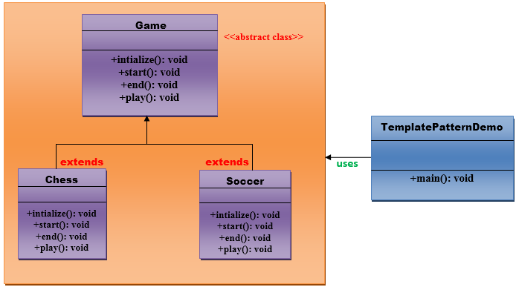

Slide 59
/This is an abstract class.
public abstract class Game {
abstract void initialize();
abstract void start();
abstract void end();
public final void play(){
//initialize the game
initialize();
//start game
start();
//end game
end();
}
}// End of the Game abstract class.

